Slide 1
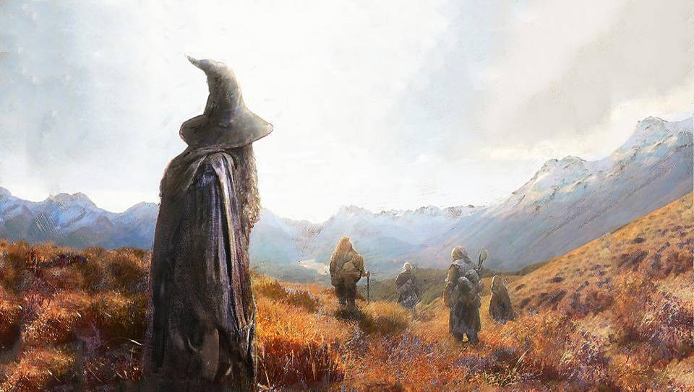
Scraping Lord of the Ring

Slide 2
Website Scraped
Demographic Data:
Movie Script:
Full Text of Books:
http://lotr.wikia.com/wiki/Main_Page
http://www.ageofthering.com/atthemovies/
https://archive.org/details/TheLordOfTheRing1TheFellowshipOfTheRing

Slide 3
Scraped Data

Slide 4
Scraped Data

Slide 5
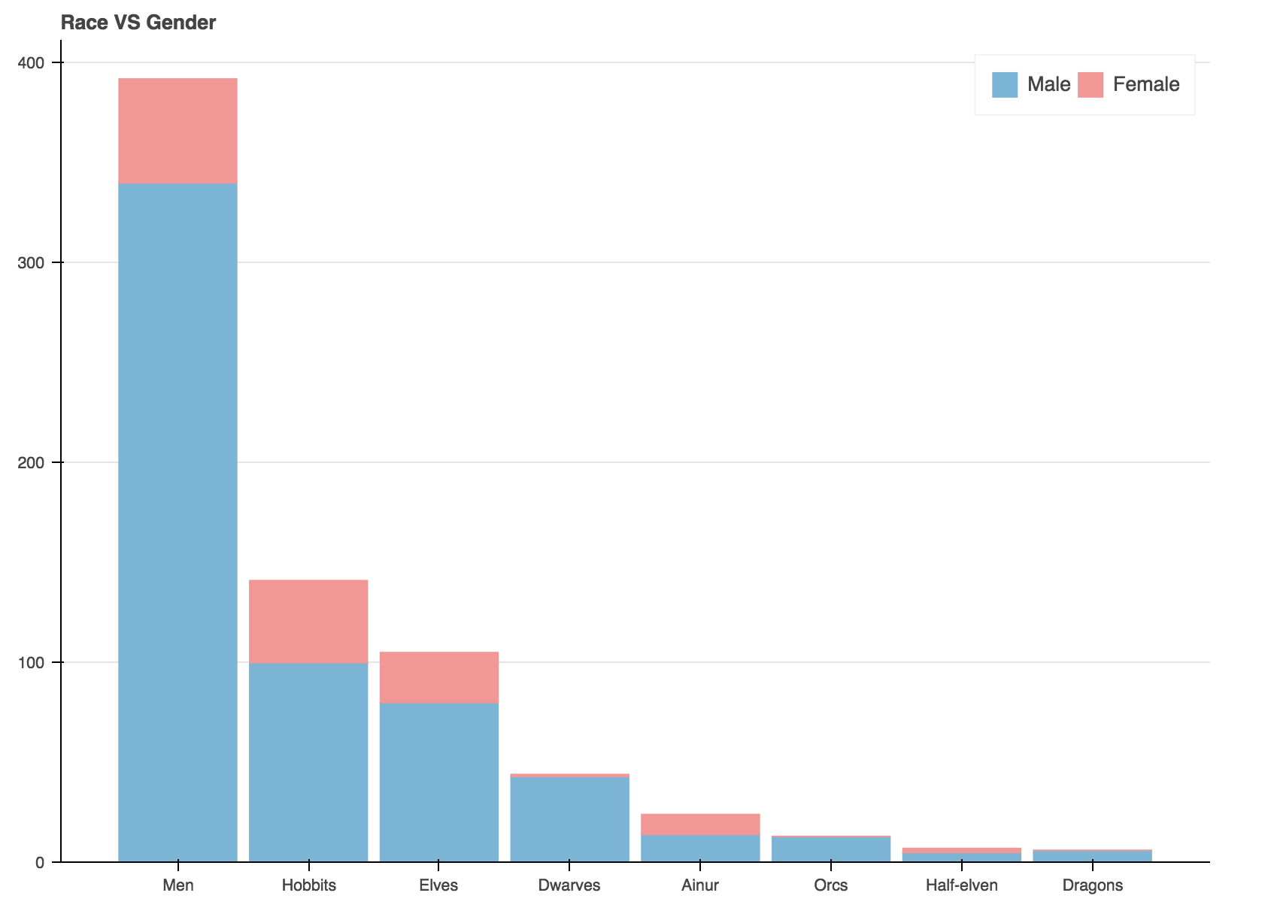
Demography in Middle Earth

Slide 6
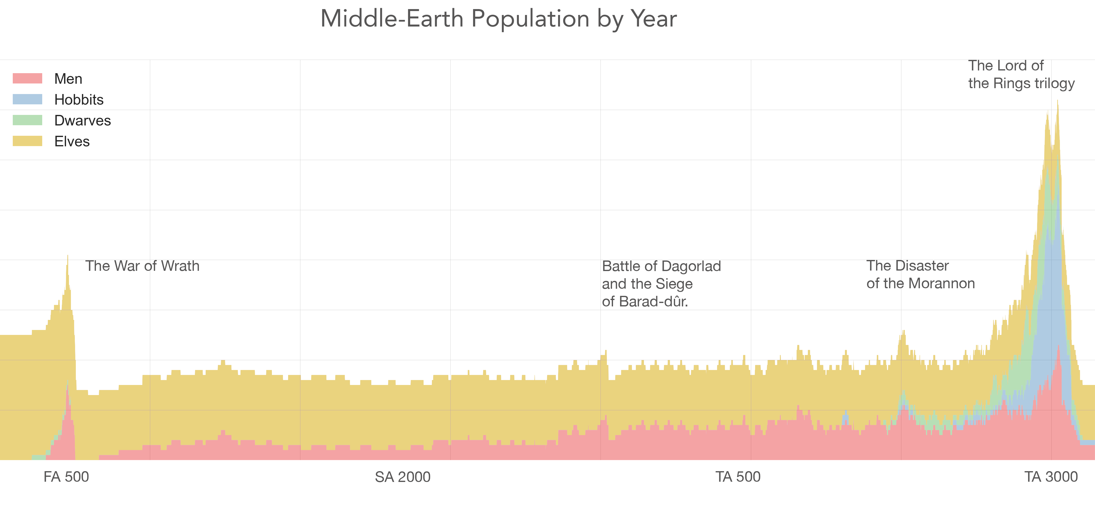
Demography in Middle Earth

Slide 7
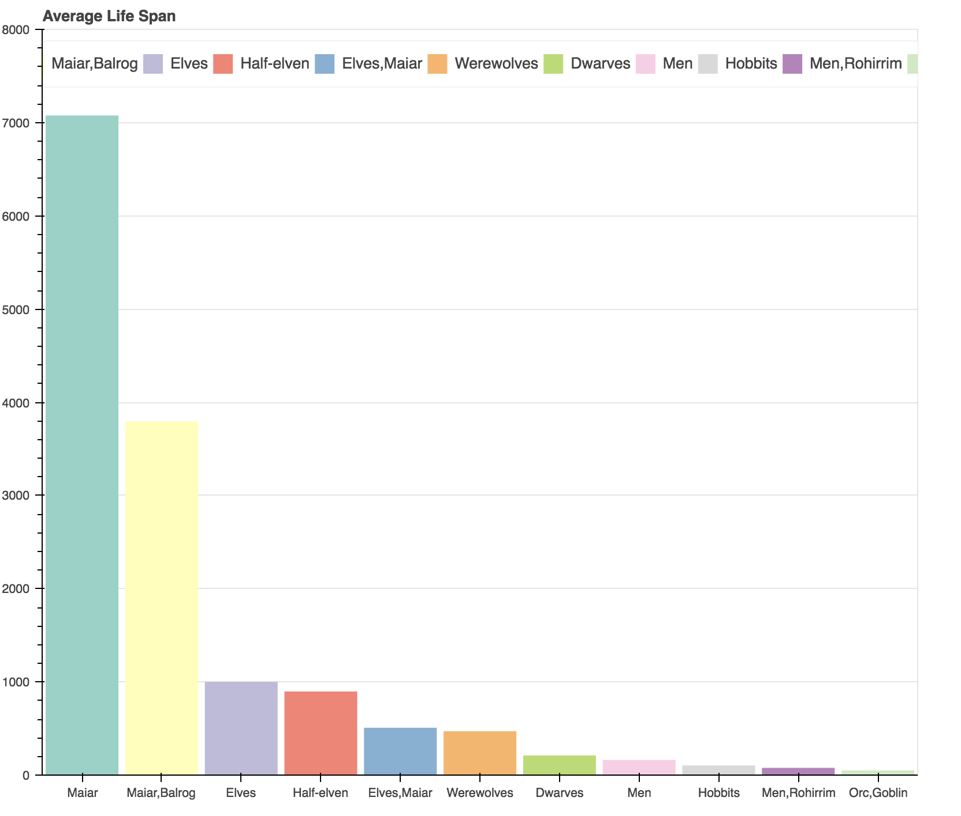
Demography in Middle Earth

Slide 8
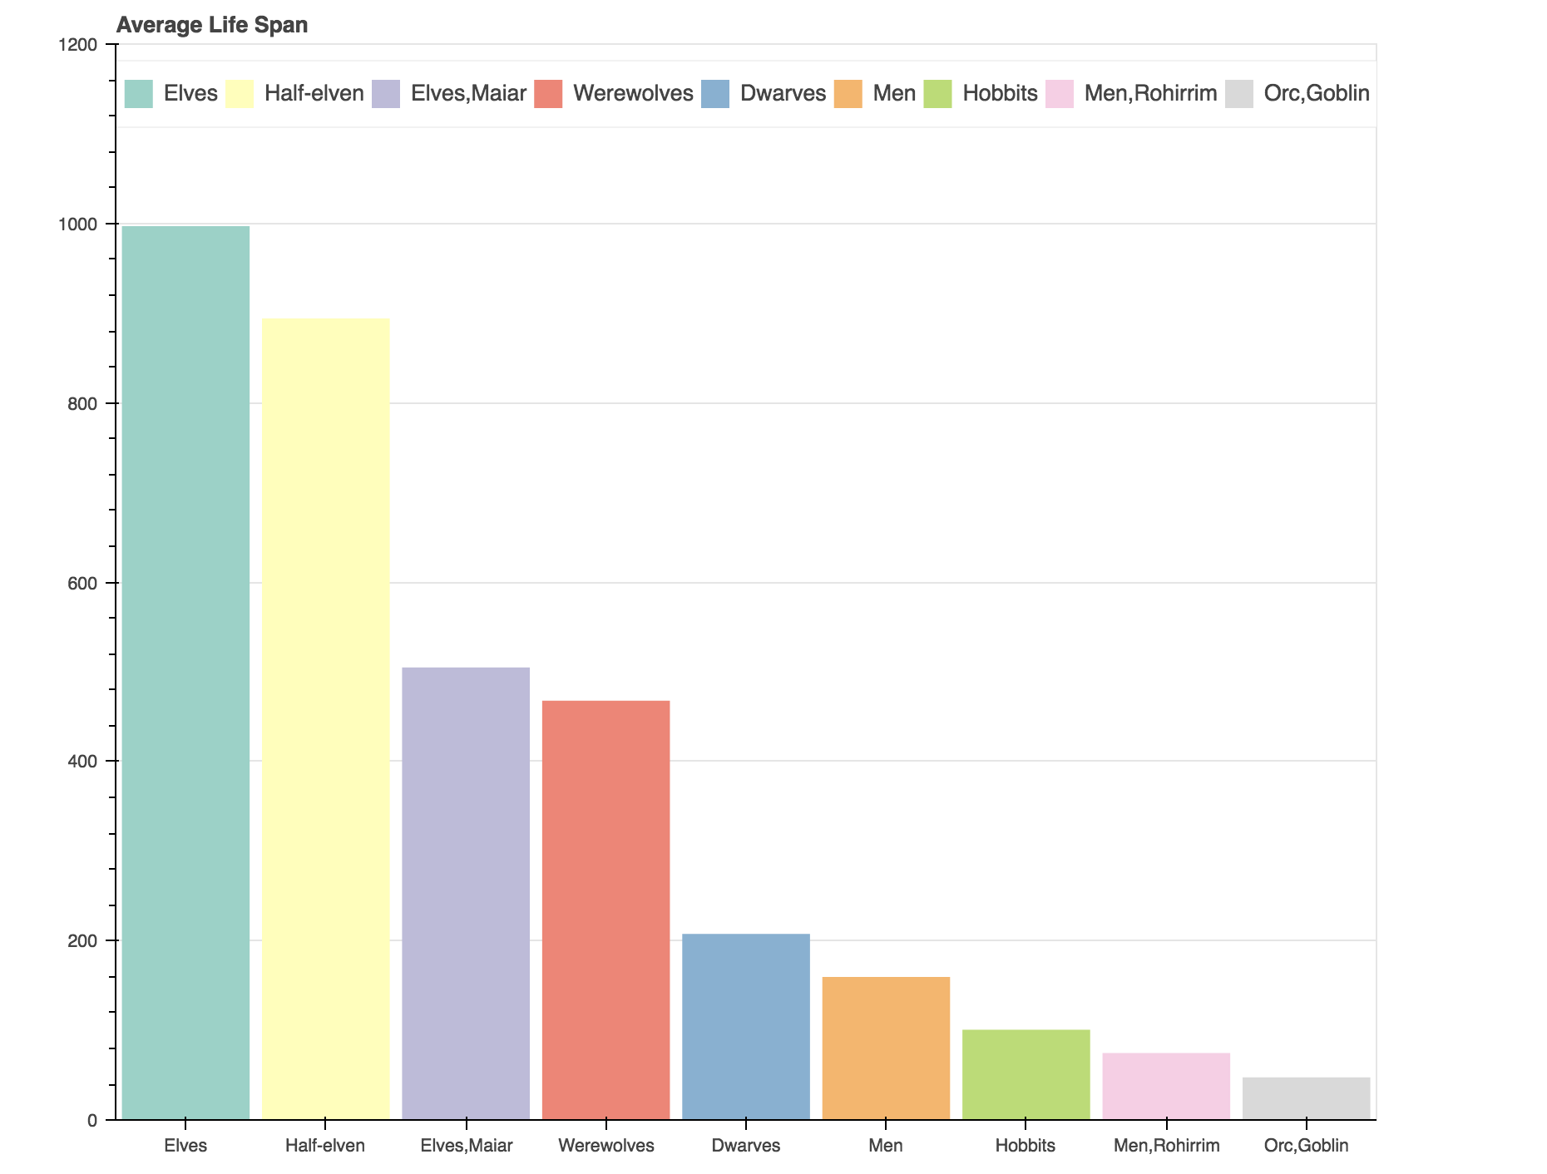
Demography in Middle Earth

Slide 9
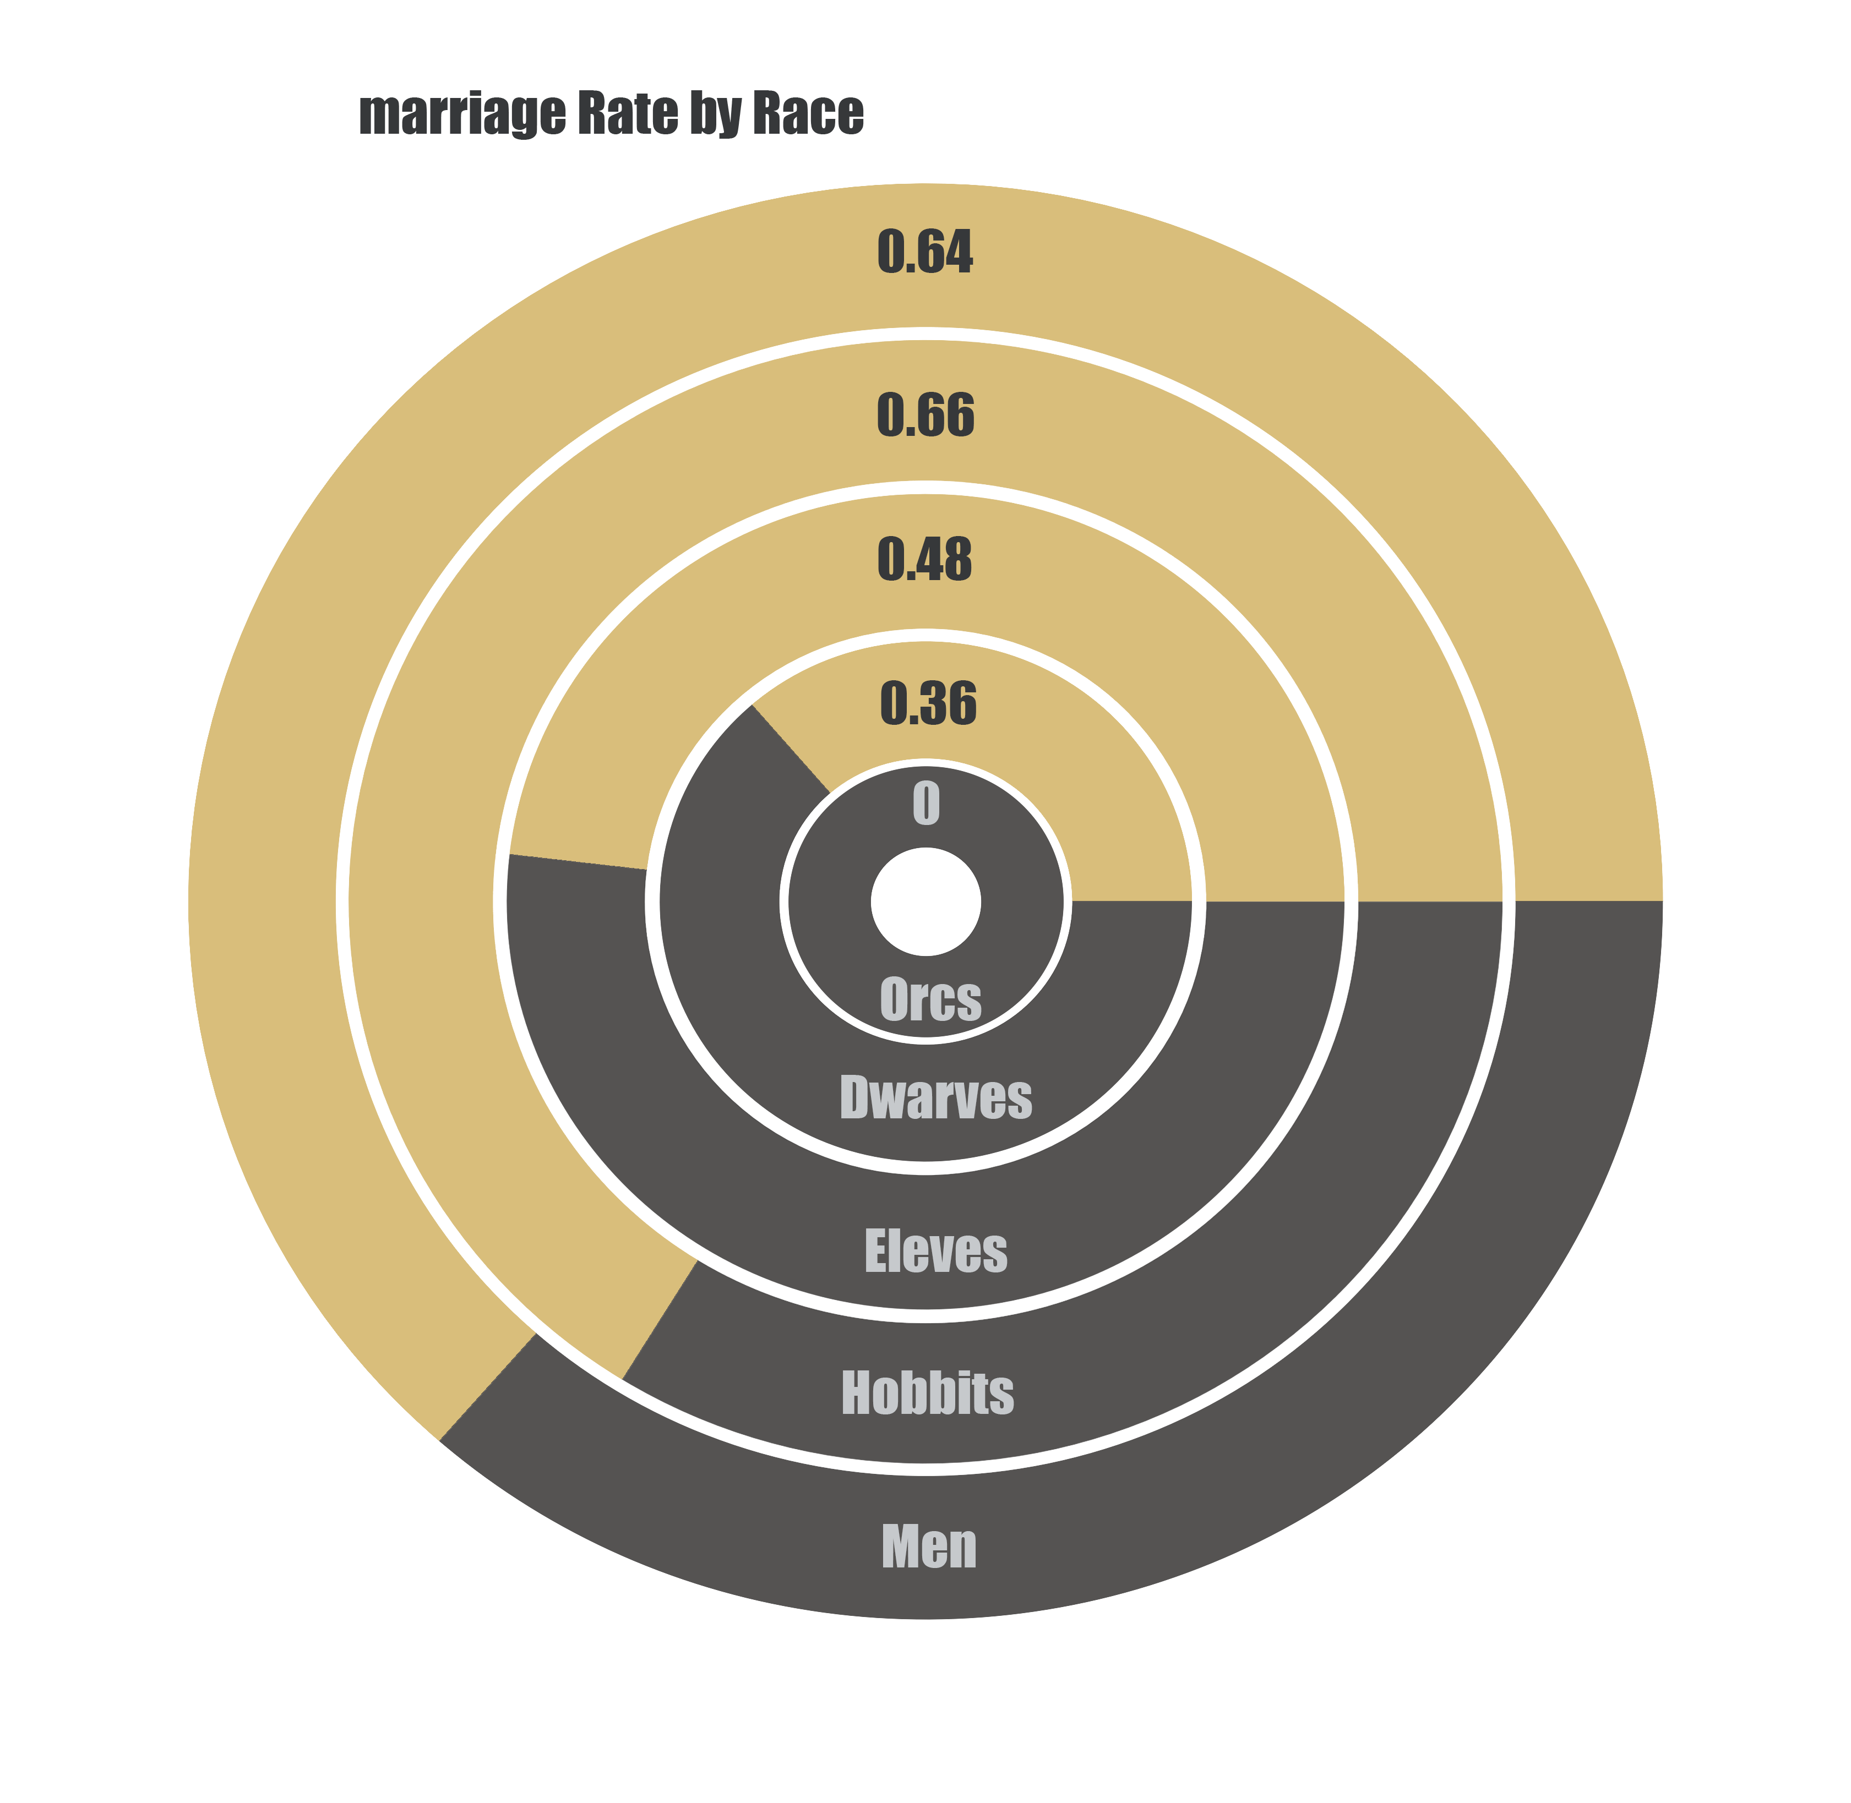
Demography in Middle Earth

Slide 10
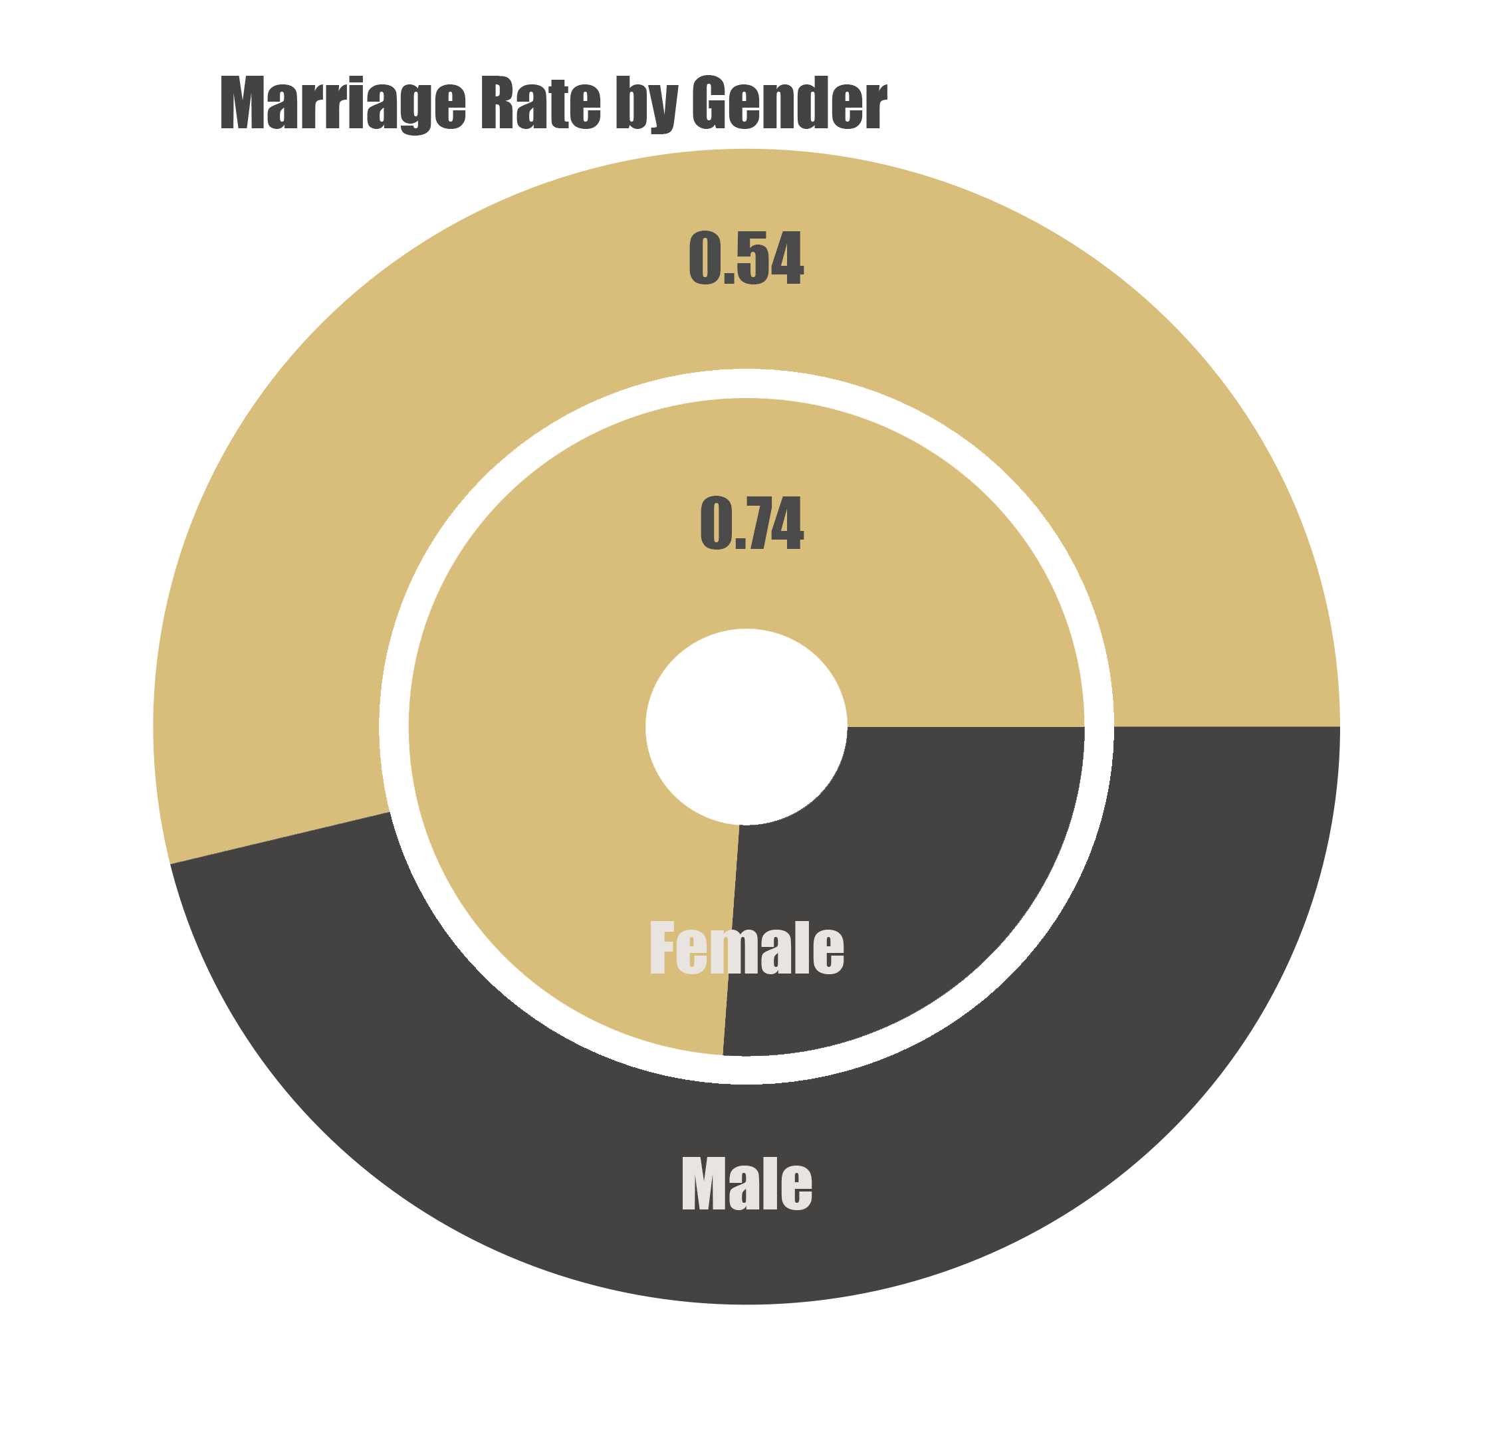
Demography in Middle Earth

Slide 11
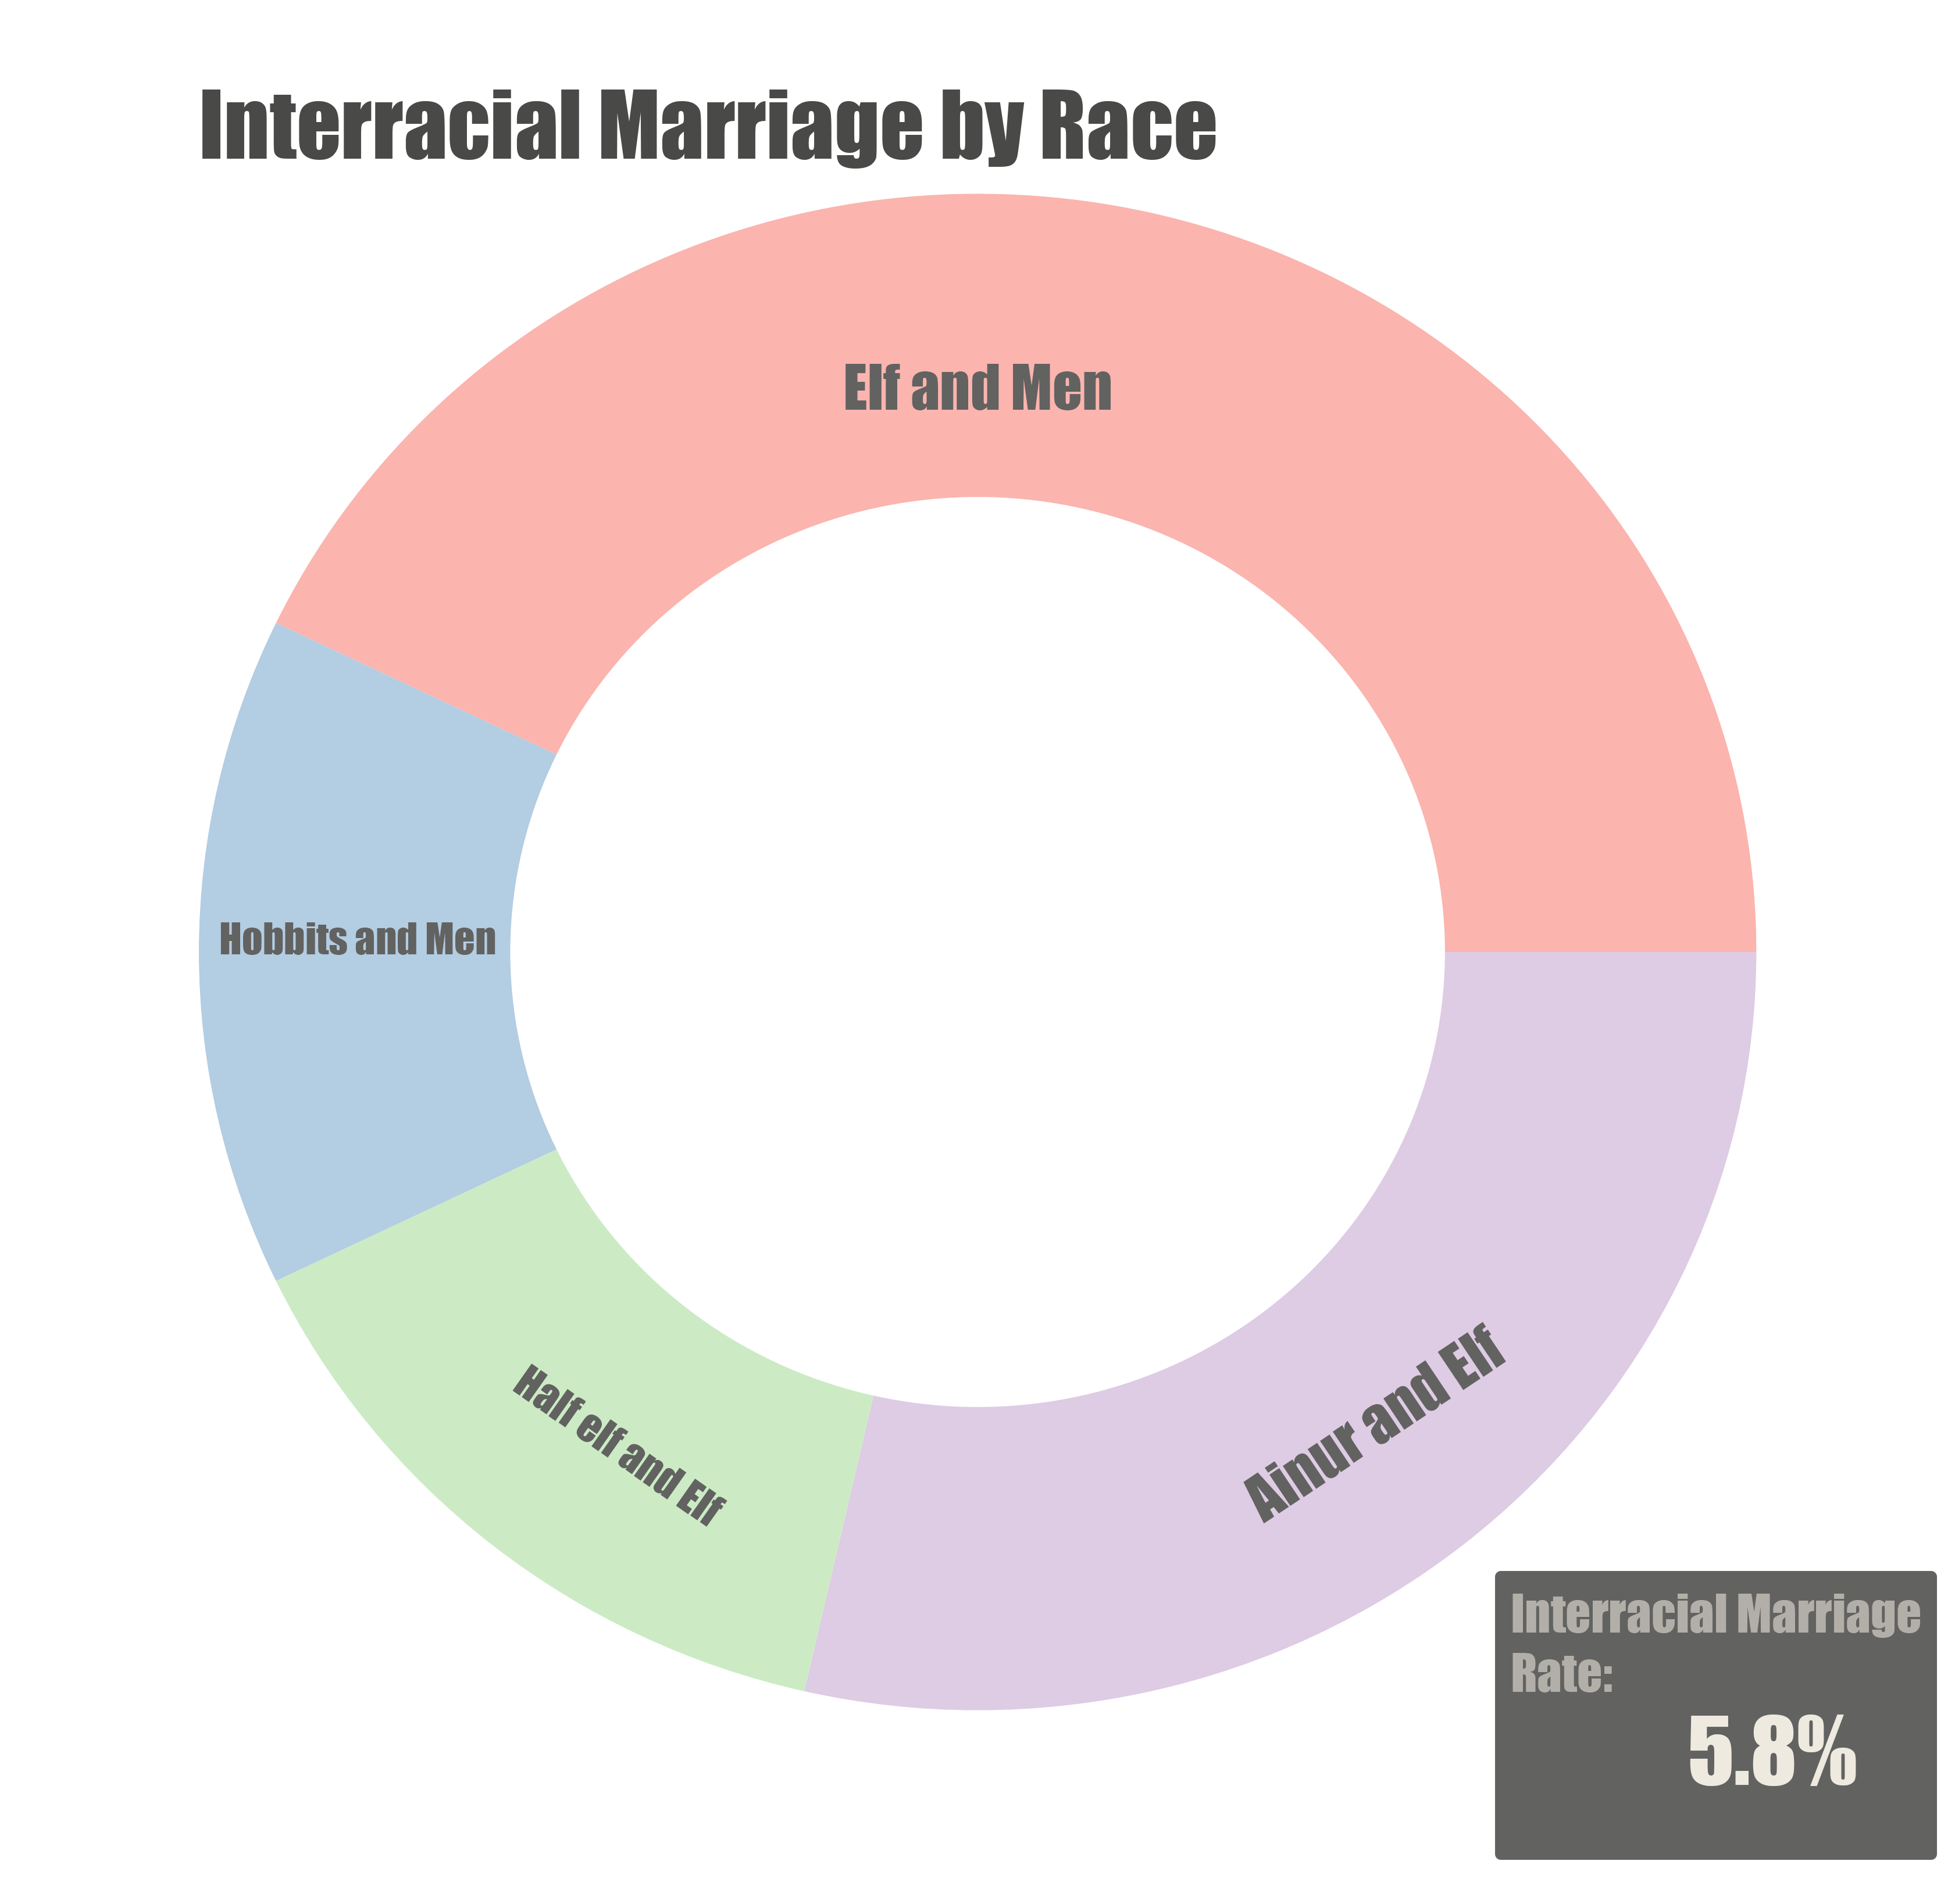
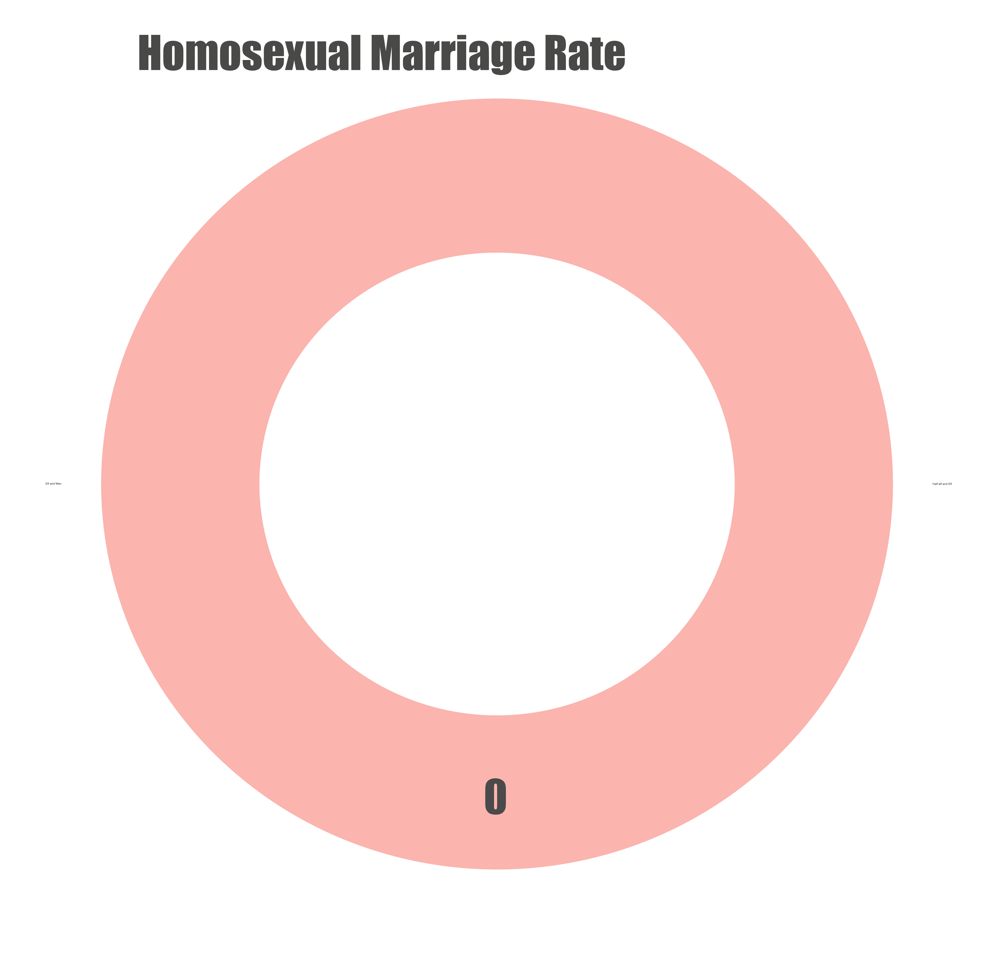
Demography in Middle Earth

Slide 12
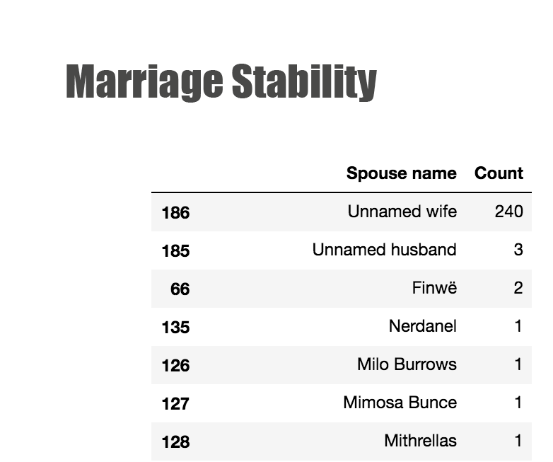
Among 1000 characters, only one character remarried

Slide 13
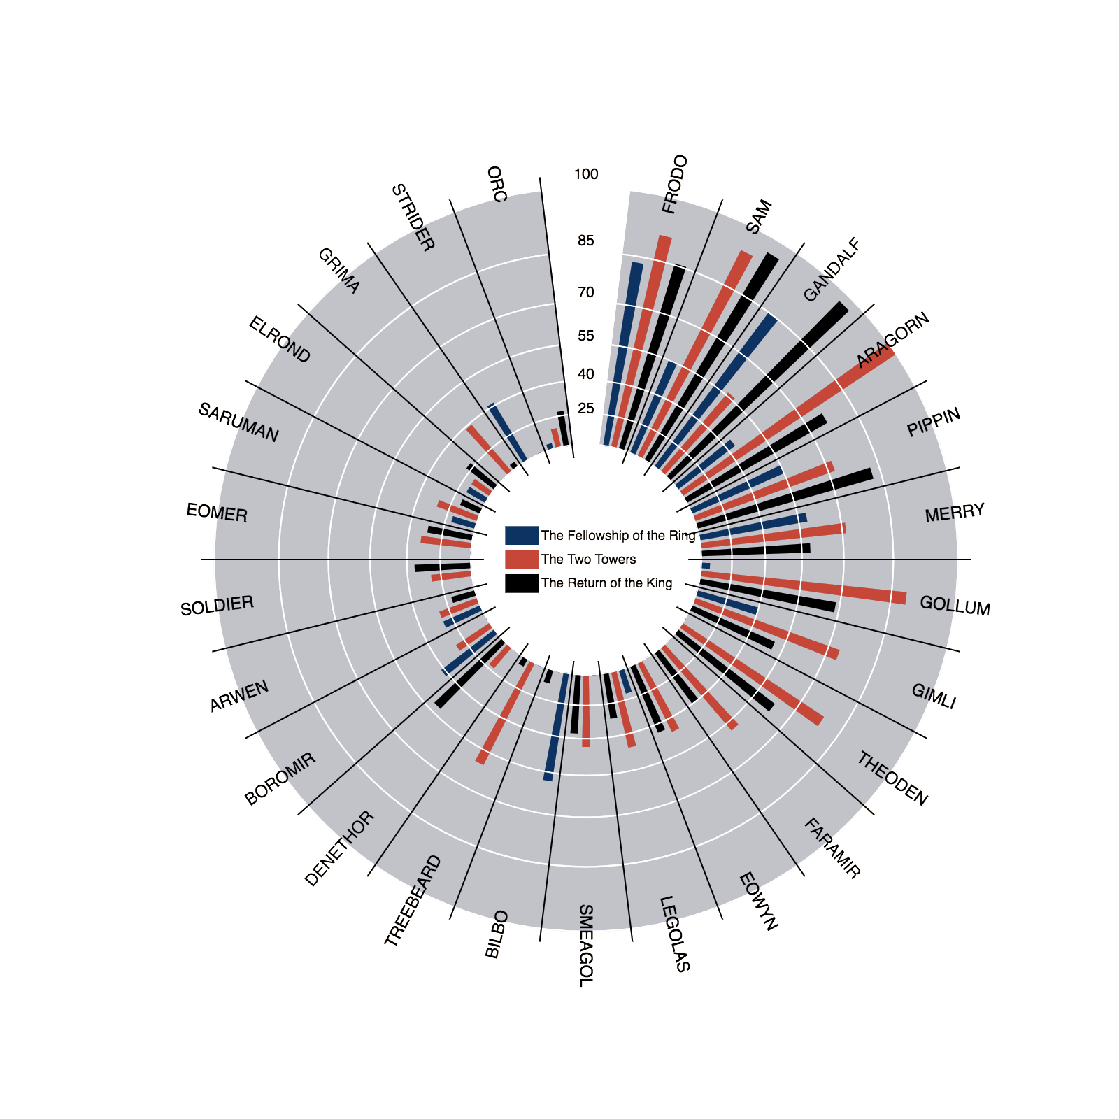
Lord of the Ring Movie Script
Lines Count in different movie by different
Characters.

Slide 14
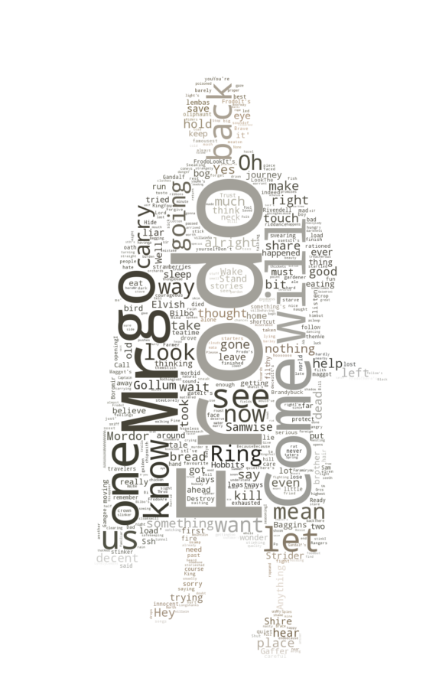
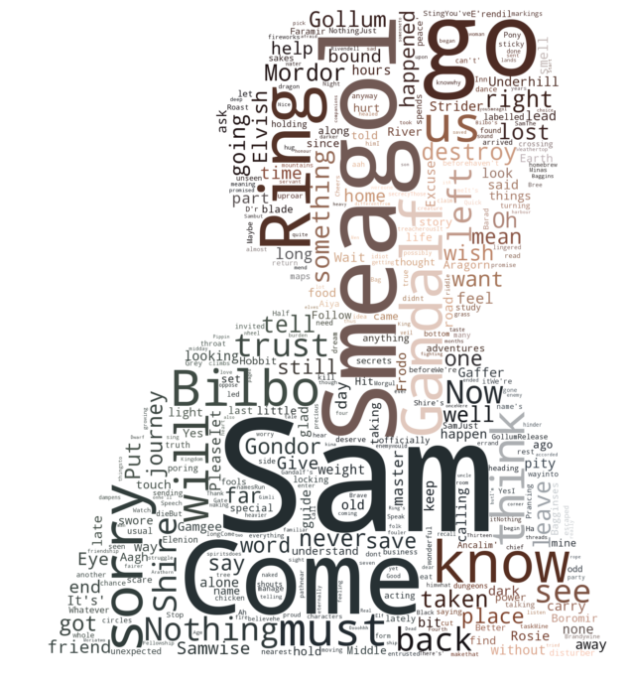
Words Spoken Frequency by Different Characters
Frodo
Sam

Slide 15
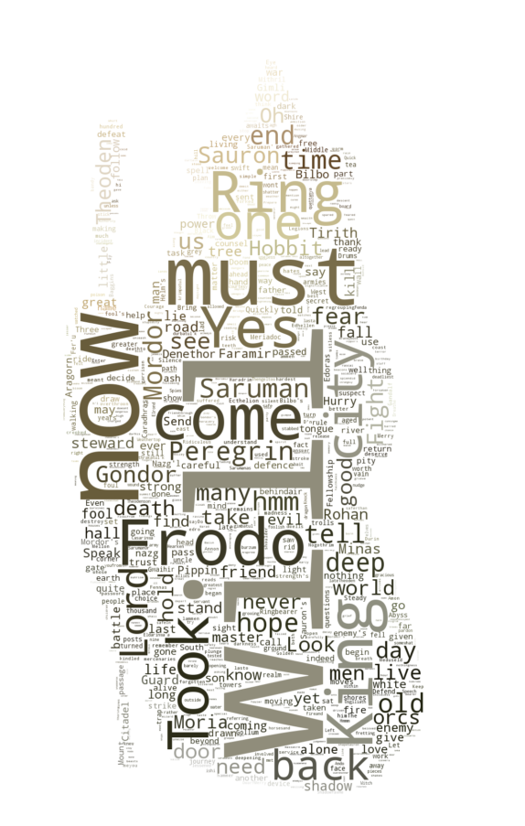
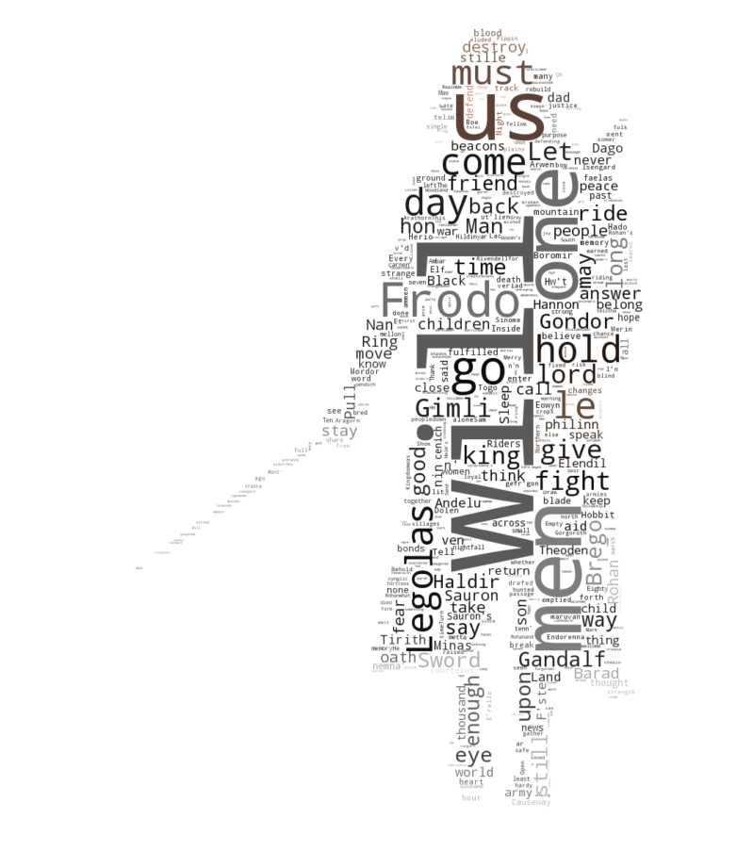
Words Spoken Frequency by Different Characters
Gandolf
Aragorn

Slide 16
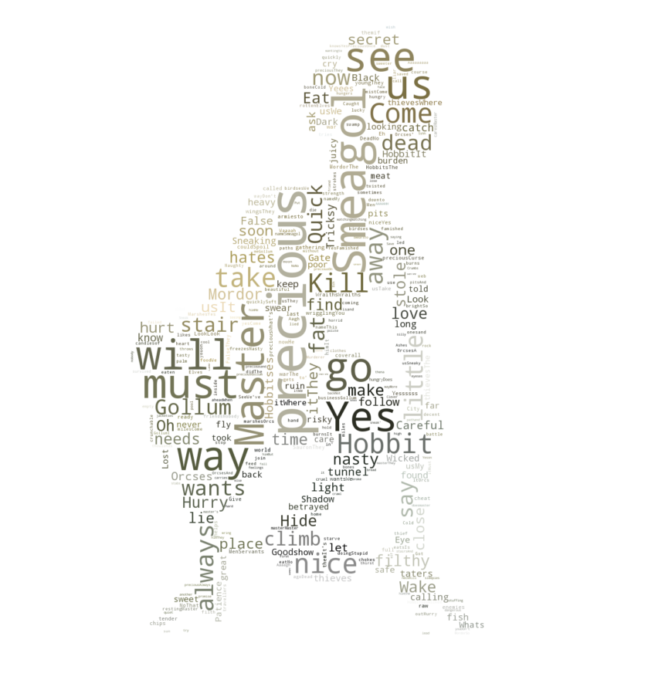
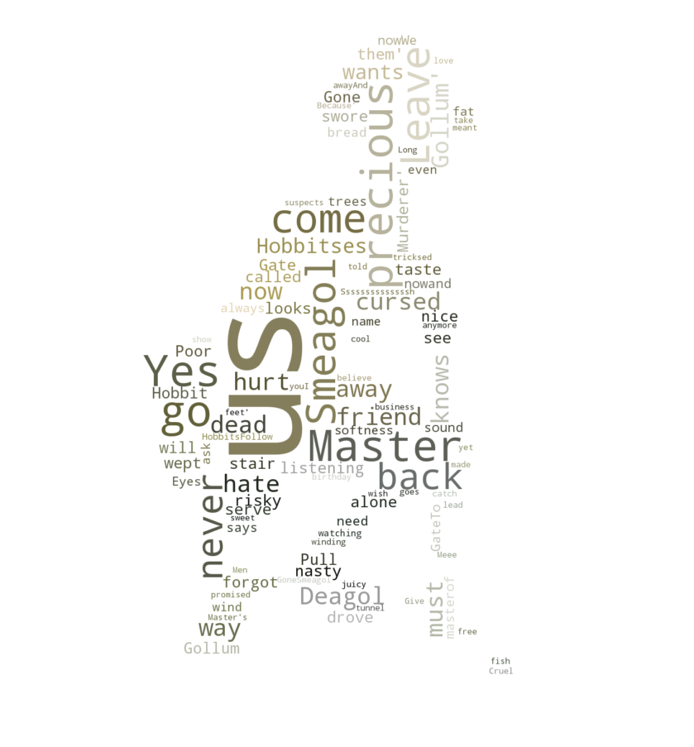
Words Spoken Frequency by Different Characters
Gollum
Sméagol

Slide 17
Sentimental Analysis on Different Characters
FRODO: 0.0744839506173
SAM: -0.112471578947
GANDALF: -0.0254785123967
ARAGORN: 0.00400476190476
GOLLUM: 0.0263746987952
SMEAGOL: 0.09537
PIPPIN: 0.182774683544
MERRY: 0.141852173913
ARWEN: -0.00713571428571

